Slide 1
An analysis of car accidents in Seattle
Capstone Coursera

Slide 2
Introduction/Business Problem
U.S. motor vehicle crashes in 2010 cost almost $1 trillion in loss of productivity and loss of life.
That same year, more than 32,999 people were killed, 3.9 million injured and 24 million vehicles damaged.
There is an imperative to try and find ways to reduce the quantity and severity of accidents.
Data scientists can employ Machine Learning (ML) techniques to predict the severity of an accident.
The City of Seattle has a publicly available dataset on traffic incidents in the city.

Slide 3
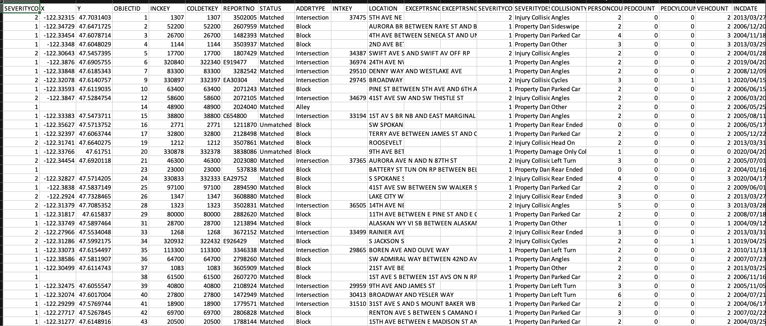
Our dataset:
Our dataset can be accessed via the following link https://s3.us.cloud-object-storage.appdomain.cloud/cf-courses-data/CognitiveClass/DP0701EN/version-2/Data-Collisions.csv, and is made up of 38 columns and 194673 rows.

Slide 4
Some Exploratory Data Analysis

Slide 5
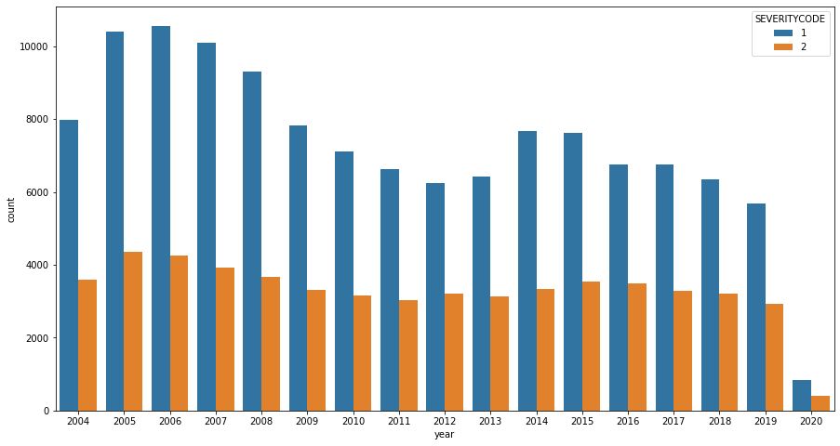
Historical record of accidents in Seattle:
Downward trend since 2006

Slide 6
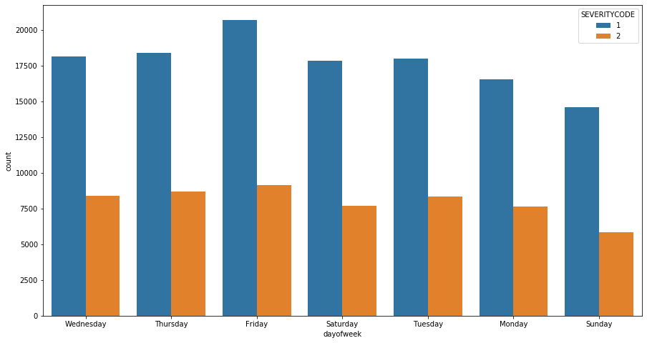
Accidents are most likely to happen on a Friday

Slide 7
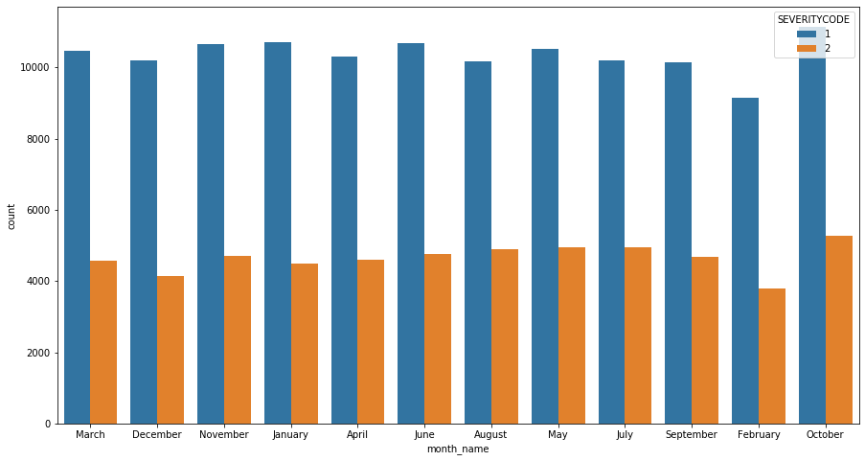
October is the month with the highest number of accidents
Most accidents happen in the days prior to Halloween

Slide 8
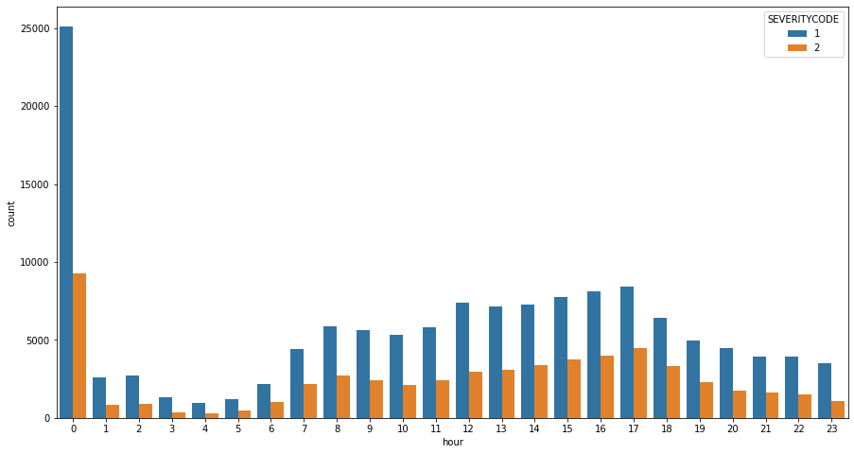
Midnight is the most dangerous time of the day
Midnight is the most dangerous time of the day
The “rush hour” after work leads to a higher number of incidents

Slide 9
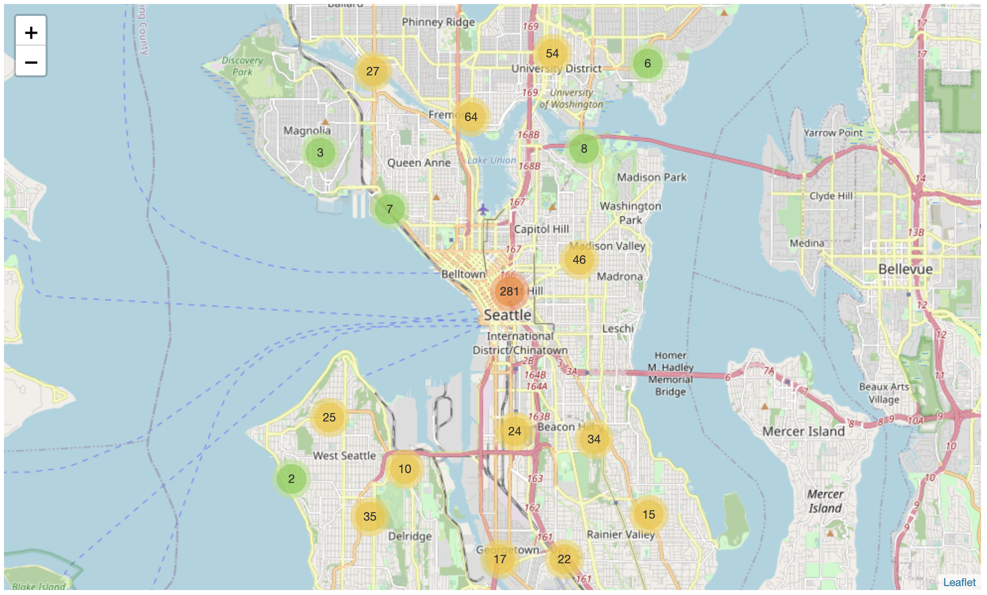
Most accidents happen in the city centre
The city centre area is by far the most “Accident-prone” area.

Slide 10
Machine Learning application

Slide 11
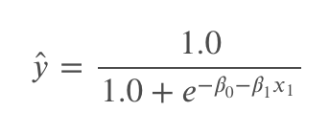
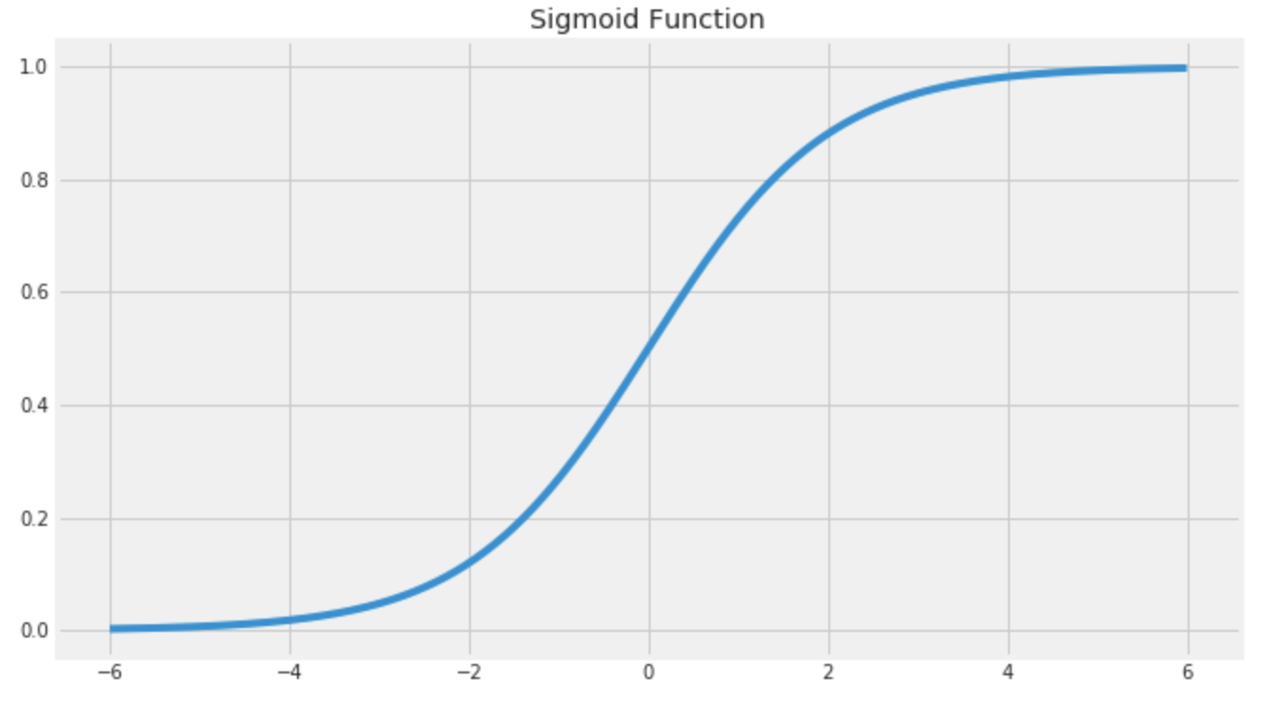
Predicting the severity of accidents in Seattle: Logistic Regression Model
We employed a logistic regression model to predict the severity of a car accident in Seattle given information related to the when, where and how of the accident.
More specifically, we tried to gauge whether an accident was of SEVERITYCODE = 2 or if it was of SEVERITYCODE = 1, i.e. SEVERITYCODE was the label we are trying to predict.
We used independent variables relating to the how, when and where of the accident to train our model.

Slide 12
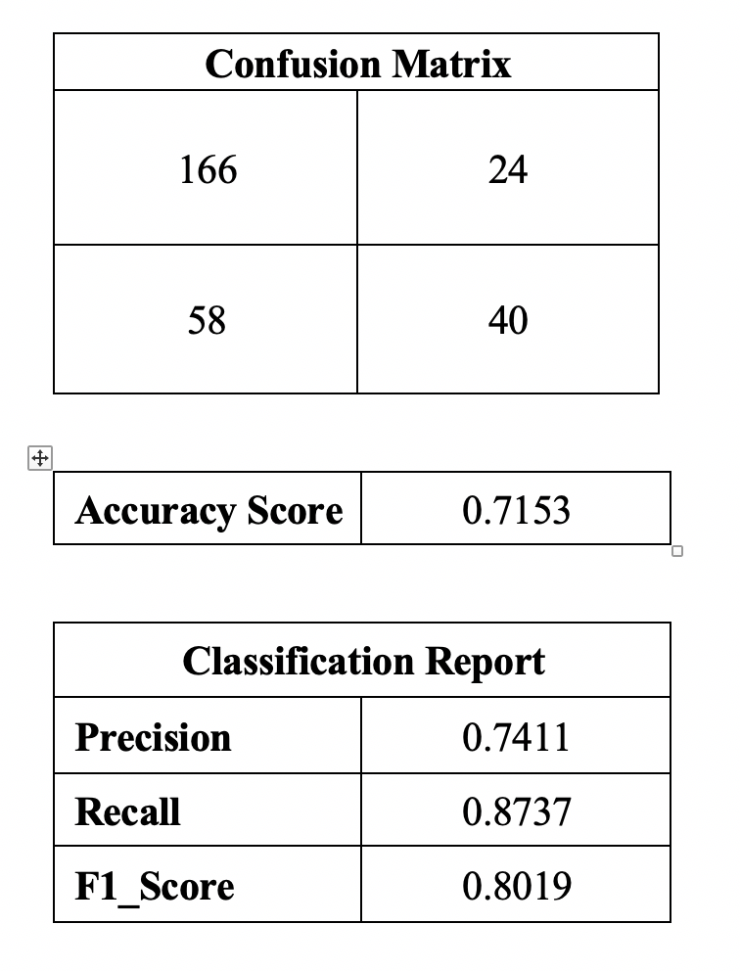
How our model performed:
We split the data into a training (70% of datapoints) and testing set (30%), and trained our model on the training subsample.
Our logistic model was 71.5% accurate in predicting if an accident is of SEVERITYCODE = 1 or SEVERITYCODE = 2.
We can improve our model by employing dimensionality reduction techniques to reduce the number of independent variables and we could also improve our performance by training the model on a larger dataset.

Slide 13
Conclusion

Slide 14
Final thoughts
Stakeholders can use the findings of this analysis to try and educate the local population about the most common types of accidents and work with local authorities to increase investment to ensuring that roads in the best conditions and that inhabitants are aware of the risks of getting the car at certain points of the year.
For example, campaigns can be launched in the weeks prior to Halloween to increase awareness of the high number of accidents that tend to occur in the days just before the event and on the night of Halloween celebrations.
Furthermore, having singled out the city centre and Rainier Valley areas, local authorities can also launch campaigns at a suburb level to increase awareness of the high number of accidents that occur in that area and to improve the condition of the roads.

